Slide 1

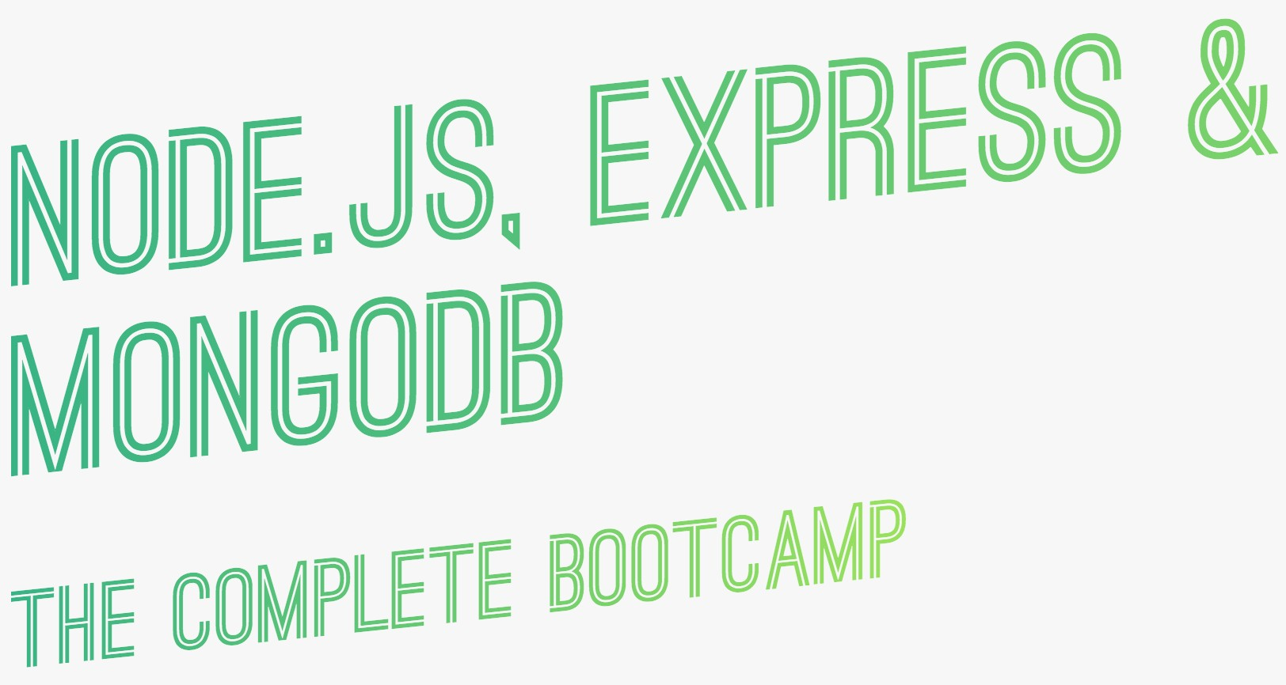
Protecting Routes of a Web Application
Presented by :
Umad Ahmad

Slide 2


Introduction (Continued)
Islamabad
z
Is it allowed to visit every area of Islamabad for each person ?
👉 Some Areas like Red Zone are NOT Allowed for some people
Reason ?
👉 _{Safety}
Imagine 2 persons with same color ,wealth, car, dress but one is allowed to enter
Red zone but another not. What's the reason ?
👉 _{Card / Passport}
_{Passport} _{= Power}

Slide 3
Introduction (Continued)
Web App
z
Is it allowed to visit every route of a Web App for each user ?
👉 Some Routes are NOT Allowed for some users.
Reason ?
👉 _{Safety}
Imagine 2 users with same browser, Network , etc…. but one is allowed to visit a route but another one not. What's the reason ?
👉 _{Passport / JWT}
_{JWT} _{= Power}

Slide 4


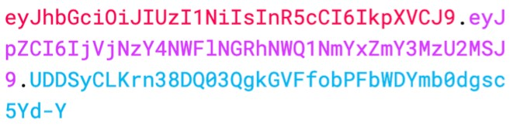

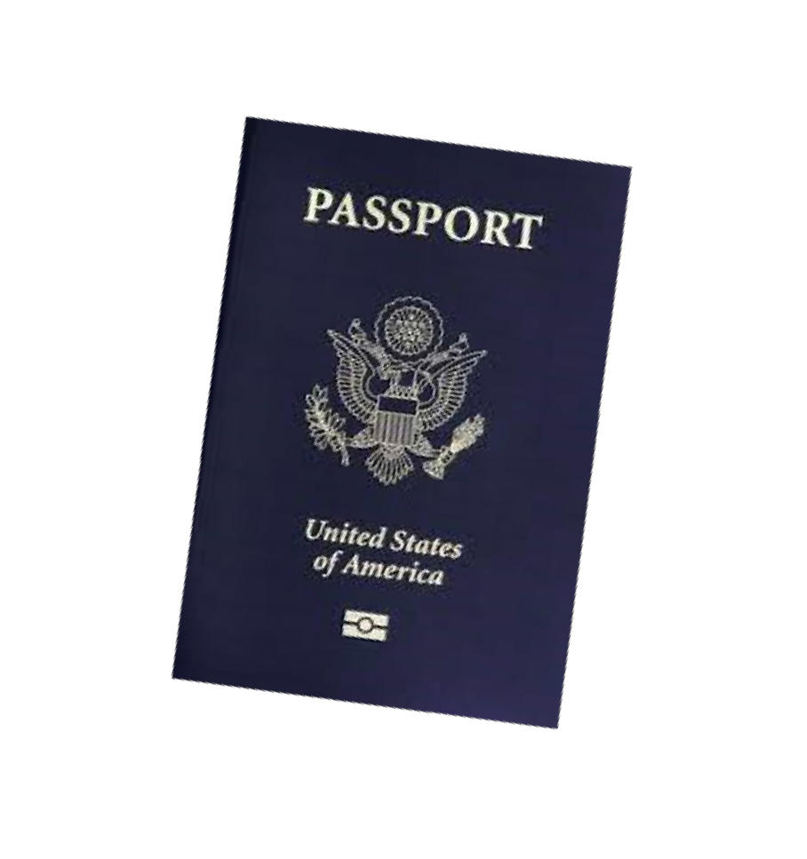
HOW JSON WEB TOKEN (JWT) AUTHENTICATION WORKS
CLIENT
SERVER
1
POST /login {email, password}
2
If user && password,
Create unique JWT
LOGIN
4
HTTPS
Store JWT (cookie or localStorage)
SECRET
3
JWT
5
GET /someProtectedRoute
JWT
6
If Valid JWT, Allow access
ACCESS
HTTPS
PROTECTED DATA
7

Slide 5



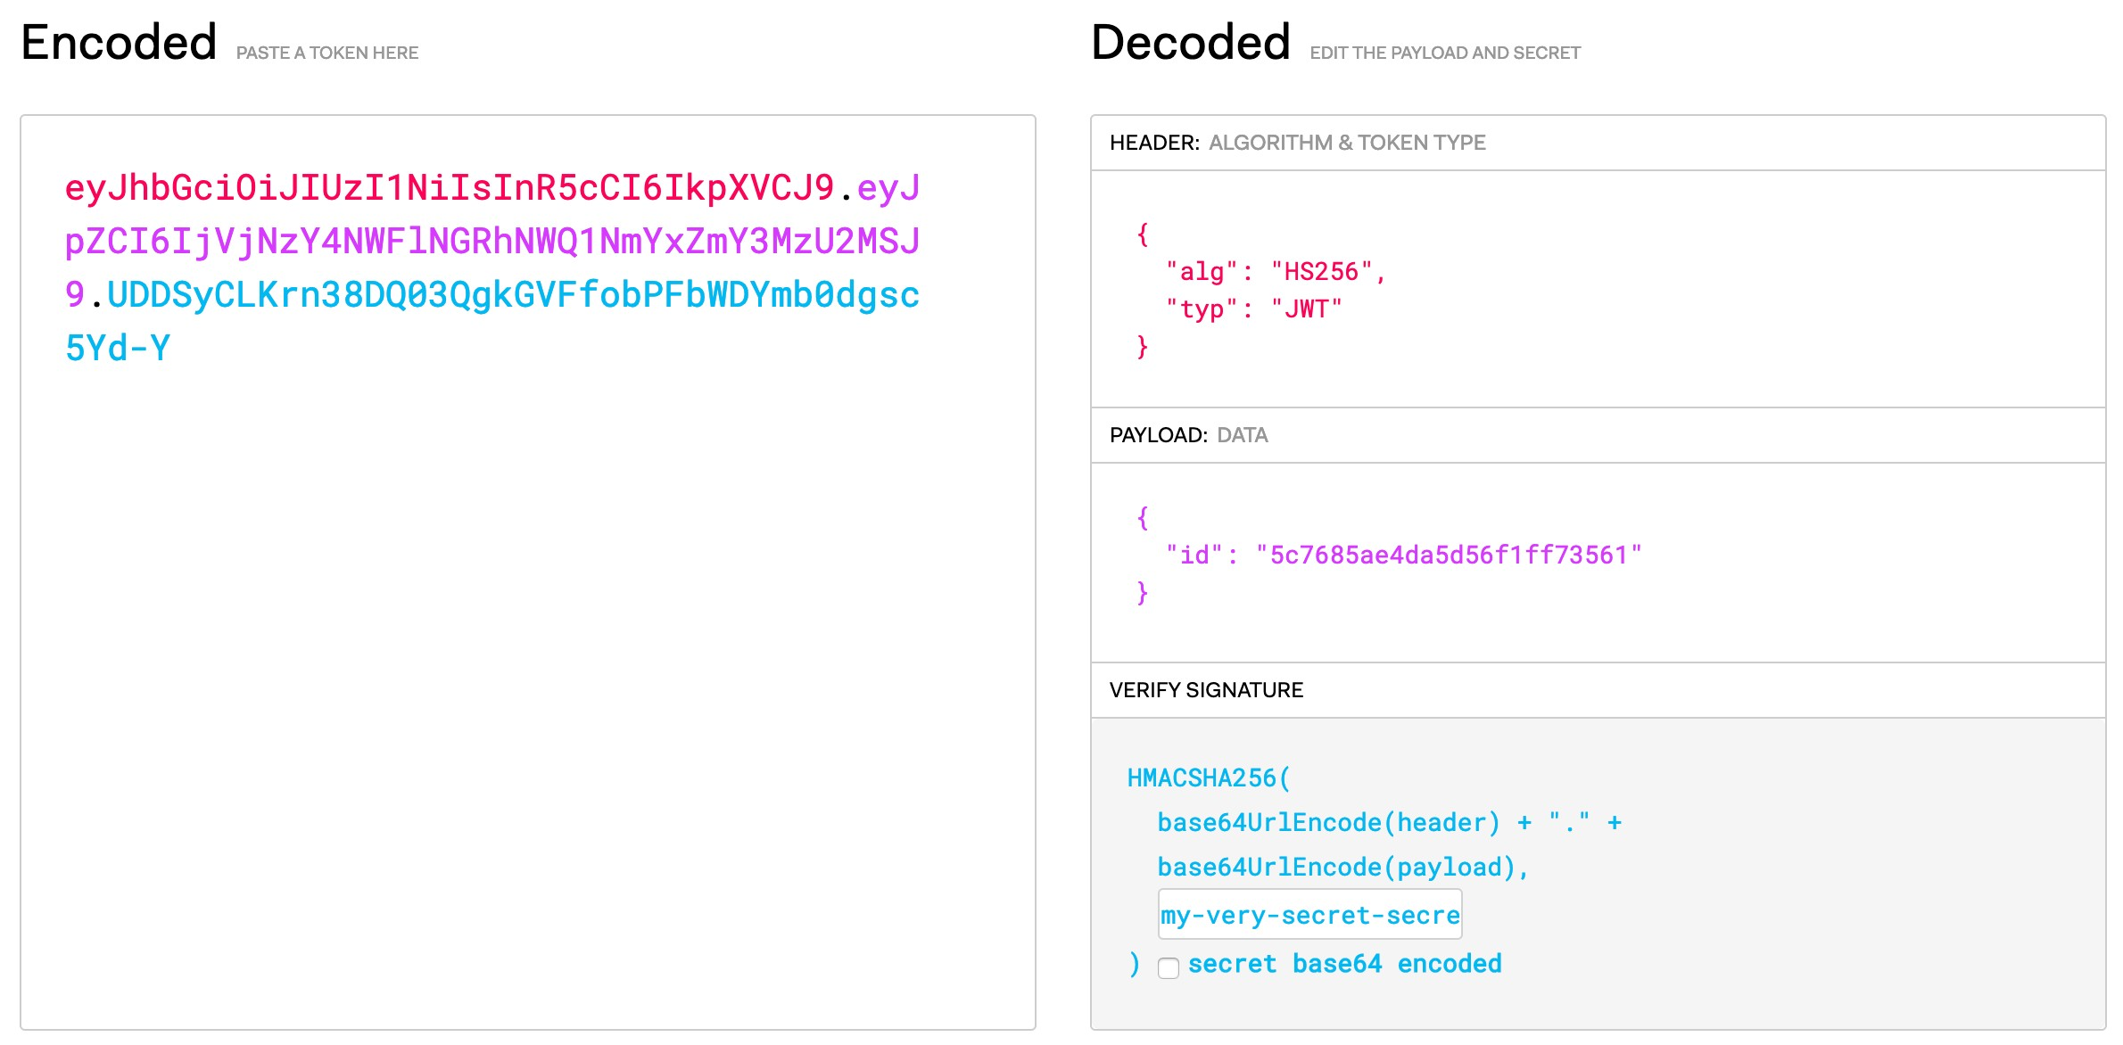
WHAT A JWT LOOKS LIKE
SECRET

Slide 6

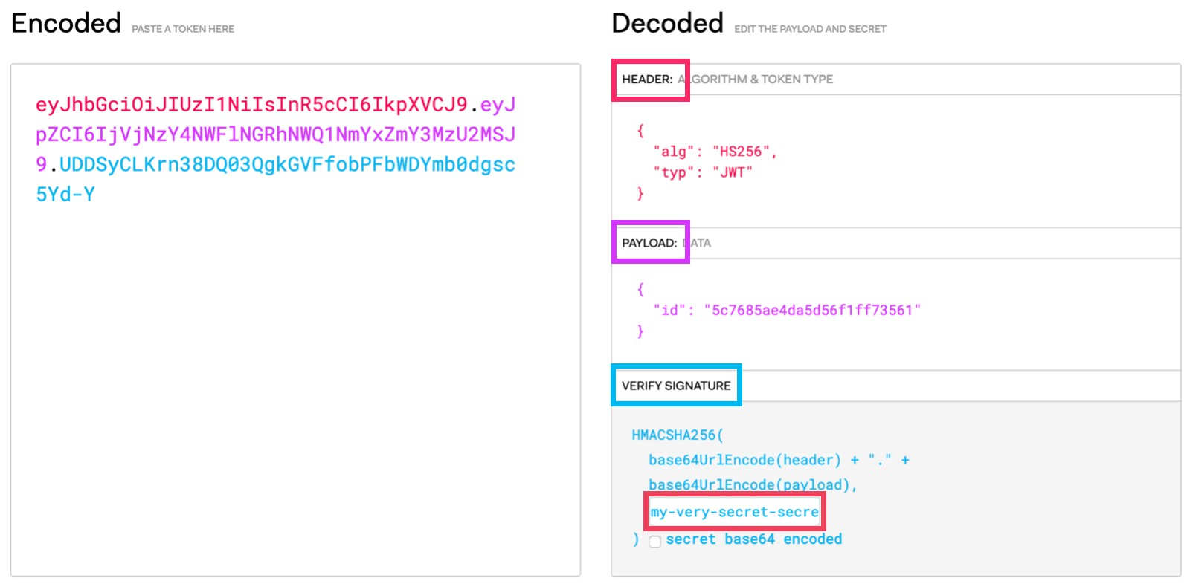

HOW SIGNING AND VERIFYING WORKS
HEADER + PAYLOAD
JWT
JWT
HEADER + PAYLOAD
VERIFYING
CLIENT
SIGNATURE
TEST SIGNATURE
ORIGINAL
SIGNATURE
SECRET
SECRET
SIGNING
COMPARE WITH ORIGINAL SIGNATURE
test signature === signature 👉 Data has not been modified 👉 Authenticated
test signature !== signature 👉 Data has been modified 👉 Not Authenticated
👉 Without the secret, one will be able to manipulate the JWT data, because they cannot create a valid signature for the new data!

Slide 7

Any Questions ?
Thank You

